Slide 1


SAP UI5 & FIORI with OData TRAINING using BAS
Anubhav Oberoy
Day – 2

Slide 2

Agenda – Day 2
Different Type of Input Field in HTML
Block Level Elements
Ordered and Unordered List in HTML
Multimedia Tags in HTML (audio, video and Iframe)
Tables in HTML
Introduction to CSS
Inline style CSS
Internal style CSS
Concept of Box Model in CSS
Concept of Pseudo Classes in CSS
External style CSS
What is JavaScript?
Basic usage of JavaScript
Important Points about JavaScript
Variables and Data Types
Arrays and Objects in JS

Slide 3
Block Level and Inline Elements in HTML
Block Level Elements
A block-level element always starts on a new line.
A block-level element always takes up the full width available (stretches out to the left and right as far as it can).
A block level element has a top and a bottom margin, whereas an inline element does not.
The <div> element is a block-level element.
div – division tag – it is used to divide screen in multiple group of elements. Every div element always starts with new line.
Here are the some block-level elements in HTML:
<p> <div> <li> <hr> <video> <h1> to <h6> etc.,
Inline Elements
An inline element does not start on a new line.
An inline element only takes up as much width as necessary.
This is a <span> element inside a paragraph.
Here are the inline elements in HTML:
<a> <input> <button> <span> <textarea> etc.,
Block Level Elements
Element 1
Element 2
Element 3
Element 4
Inline Elements
Element 1
Element 2
Element 3
Element 4

Slide 4
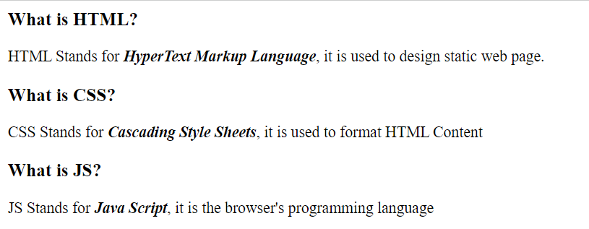
Hands – on: Block Level Elements
Now we will put the Heading and the definition of HTML, CSS and JS in different <div> tags, to demonstrate the block of content.
Code Link:
index.html

Slide 5
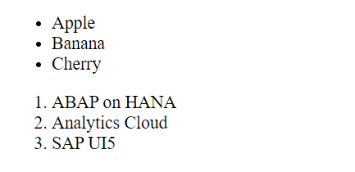
Ordered and Unordered List
HTML lists allow web developers to group a set of related items in lists.
Unordered HTML List:
An unordered list starts with the <ul> tag. Each list item starts with the <li> tag.
The list items will be marked with bullets (small black circles) by default.
Ordered HTML List:
An ordered list starts with the <ol> tag. Each list item starts with the <li> tag.
The list items will be marked with numbers by default.
An unordered HTML list:
Item
Item
Item
Item
An ordered HTML list:
First item
Second item
Third item
Fourth item
Hands – on: Ordered and Unordered List
Now we will create the ordered and unordered list in our web page using the <ul>, <ol> and <li> tags.
Code Link:
index.html

Slide 6
Introduction to Multimedia Tags in HTML
Multimedia on the web is sound, music, videos, movies, and animations.
Audio
The <audio> tag is used to embed sound content in a document, such as music or other audio streams.
The controls attribute adds video controls, like play, pause, and volume.
Video
The <video> tag is used to embed video content in a document, such as a movie clip or other video streams.
The controls attribute adds video controls, like play, pause, and volume.
Iframe
The <iframe> tag specifies an inline frame.
This is the easiest way to embed videos in HTML.
An inline frame is used to embed another document within the current HTML document.
We can also use <iframe> element to add YouTube videos in our web page.

Slide 7

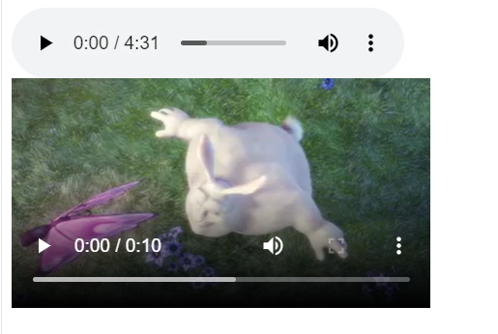
Hands – on: Multimedia Tags in HTML
Add the Multimedia elements to our web page using the audio, video and iframe tag.
Code Link:
index.html

Slide 8
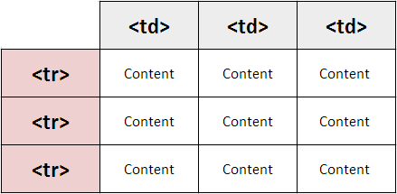
Introduction to Table element in HTML
HTML tables allow web developers to arrange data into rows and columns.
A table in HTML consists of table cells inside rows and columns
The <table> tag defines an HTML table.
An HTML table consists of one <table> element and one or more <tr>, <th>, and <td> elements.
The <tr> element defines a table row, the <th> element defines a table header, and the <td> element defines a table cell.
By default, the text in <th> elements are bold and centered, but you can change that with CSS.

Slide 9
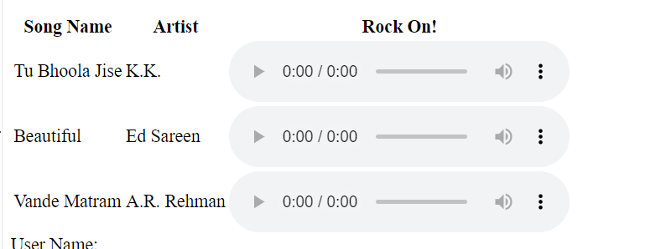
Hands – on: Table using HTML
Create a table in our HTML page using the <table> element and embed the audio tags in that table.
Code Links:
index.html

Slide 10




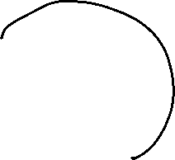















Slide 11

Introduction to CSS
CSS Stands for Cascading Style Sheets, it is used to format/beautify the HTML content.
CSS describes how HTML elements are to be displayed on screen.
CSS saves a lot of work. It can control the layout of multiple web pages all at once.
We need CSS because HTML can only generate static content w/o coloring, formatting, borders, beautification.
Before css we have to use HTML tags for formatting which was very cumbersome
<p>I <b><color value=“red”>love</color></b><font val=“Calibri”>India<font></p>
There are 3 ways we can apply CSS on HTML Content
Inline CSS – applied at each element level <tagname style=“prop:val;prop:val;..”>….
Internal CSS – applied at the page level to target one or more than one html elements on the page. It is fully reusable.
External CSS – Where the CSS is applied by putting code in a reusable css file and later use the link tag to connect the same.

Slide 12
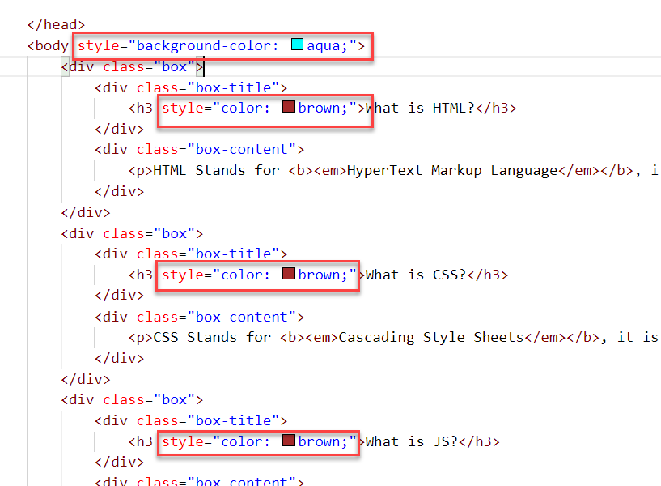
Inline CSS
Inline CSS is used to style a specific HTML element.
To apply Inline CSS add a style attribute to each HTML tag.
Inline styles in CSS could be useful for previewing changes instantly.
It can be useful when adding CSS rules to only one or two elements.
Syntax to apply Inline style CSS
<htmltag style="cssproperty1:value; cssproperty2:value;"> </htmltag>
We can see all the available CSS properties on the W3C:
https://www.w3schools.com/css/default.asp
Disadvantages of using Inline style CSS:
These styles cannot be reused anywhere else.
Adding CSS using this technique is time-consuming.
These styles are tough to be edited because they are not stored at a single place.

Slide 13
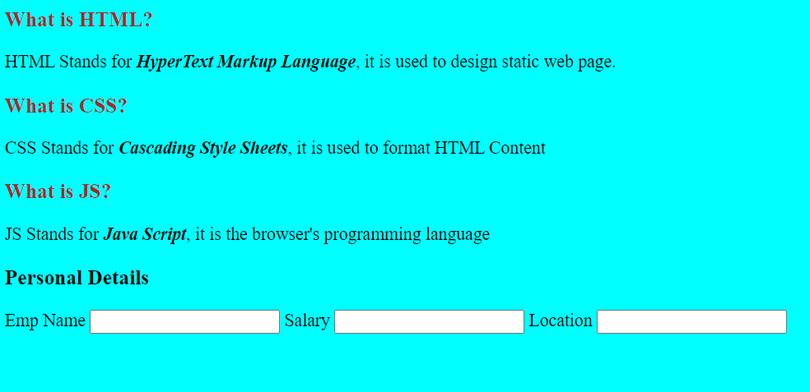
Hands – on: Inline CSS
Apply basic style to our html page using the Inline CSS technique.
For this exercise we will create a new file named cssbasics.html in our current folder.
Code Link:
cssbasics.html

Slide 14
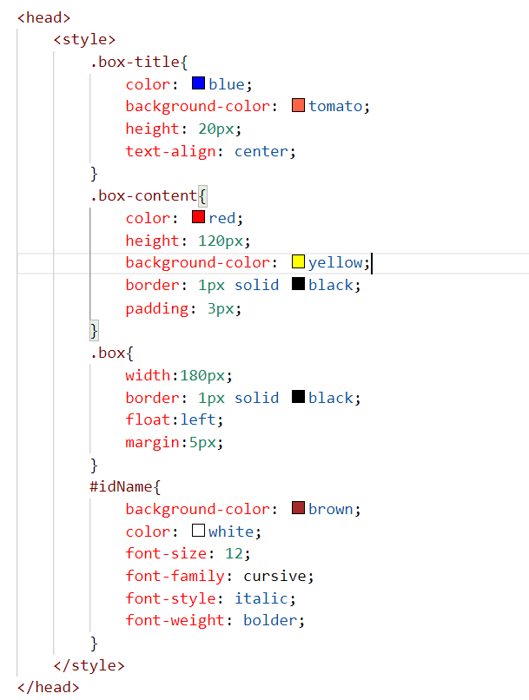
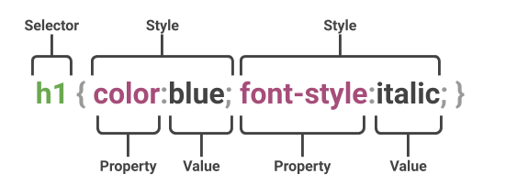
Internal CSS
The internal style sheet is used to add a unique style for a single document. It is defined in <head> section of the HTML page inside the <style> tag.
This CSS style is an effective way to style single pages.
Internal CSS is applied using the Selectors in the HTML page, which makes the styling easy.
Syntax to apply the Internal style CSS
<style>
selector{
propertyname: value;
propertyname: value;
}
</style>
Selector: CSS selectors are used to "find" (or select) the HTML elements you want to style.
The are three type of selectors in CSS.
#id: Id of the single element
.classname: group of elements which has same classification property
Tagname: group of elements which has same tag name

Slide 15
Box Model in CSS
In CSS, the term "box model" is used when talking about design and layout.
All HTML elements can be considered as boxes.
The CSS box model is essentially a box that wraps around every HTML element. It consists of: margins, borders, padding, and the actual content. The image below illustrates the box model:
margin
border
border
padding
Html element
Html element

Slide 16
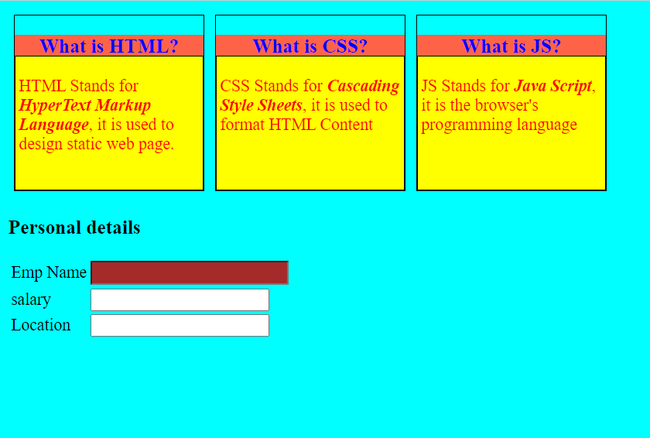
Hands – on: Internal CSS
Now will apply the CSS using the Internal style CSS to our block level elements (box and box-content), will also see how to use different types of selectors for styling the content.
We will also see some commonly used properties of CSS.
Code Links:
cssbasics.html

Slide 17
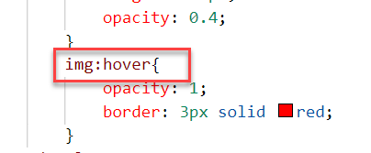

Pseudo-classes in CSS
A pseudo class is used to apply effects on the control based on special conditions or activity.
For example, it can be used to:
Style an element when a user mouses over it
Style visited and unvisited links differently
Style an element when it gets focus
Syntax to use pseudo class
selector:pseudo-class { property: value; }

Slide 18
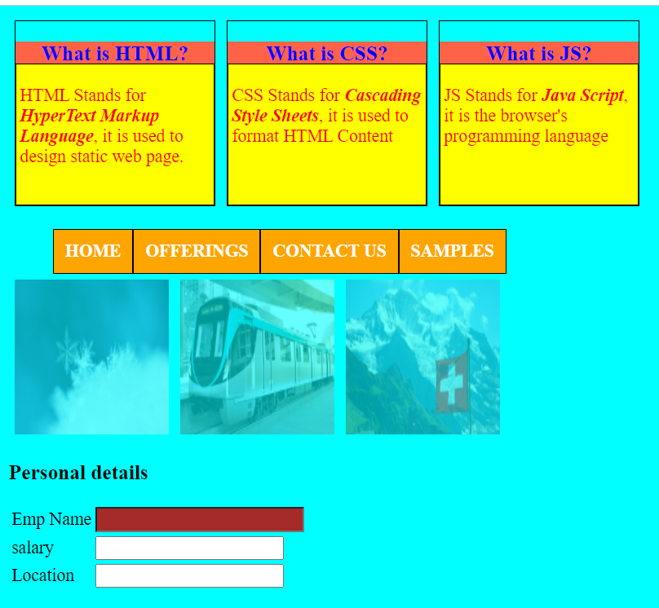
Hands – on: Pseudo Classes in CSS
Add three images and style them using the hover class of CSS. So when we hover the mouse on the image gets highlighted.
Also create a Navbar in our HTML Page.
In this exercise we will also see how to apply styling on the child elements using the parent element..
Code Links:
cssbasics.html

Slide 19
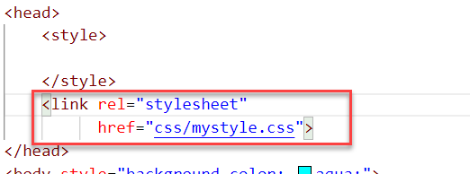
External CSS
In external CSS, we link the web pages to the external .css file.
This CSS type is a more efficient method, especially for styling a large website. By editing one .css file, you can change your entire site at once.
Since the CSS code is in a separate document, your HTML files will have a cleaner structure and are smaller in size.
An external style sheet can be linked to an HTML document using the <link> tag. The <link> tag goes inside the <head> section.

Slide 20
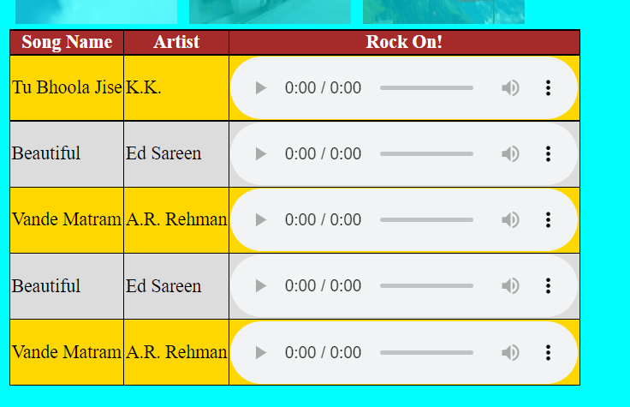
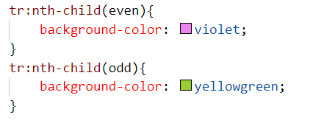
Hands – on: External CSS
Now we will use the External style CSS to style our HTML page.
We will also style our table element to demonstrate the concept of styling the child elements.
Exercise code:
cssbasics.html
mystyle.css

Slide 21
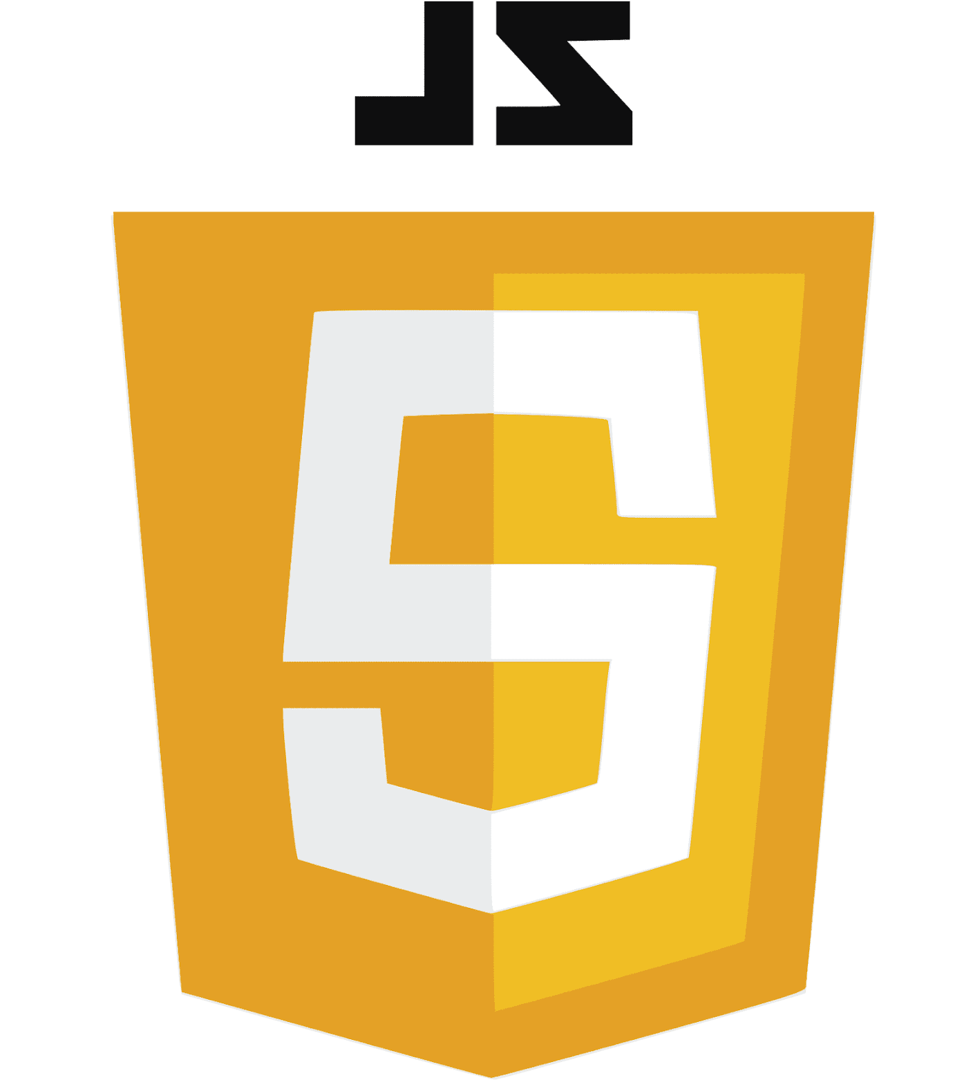
What is JavaScript?
JavaScript is the Programming Language for the Web. Simply, JavaScript is browser’s programming language.
Every browser directly understand JavaScript.
Java and JavaScript are completely different in their design, purpose and usage.
JavaScript is the world's most popular programming language.
JavaScript is among the most powerful and flexible programming languages of the web. It powers the dynamic behavior on most websites.
There are two types of JavaScript:
Client-Side JS
Server-Side JS
Client-Side JS:
When the JS code runs on the client side (browser), then it is known as Client-side JS.
It is simple, easy and used in web development.
Since the code runs on client side, it is extremely fast and we can test/debug it directly in browser.
Server-side JS:
When the JS code runs on the server side, then it is known as Server Side JS.
This gives a benefit to developer to learn only one language with which they can code on both side.
Server side JS can be used to validate data, db look ups, send mails, trigger integration.
NodeJS is one of the example of Server Side JS. (It is a framework developed to work on server side).

Slide 22
Basic Usage of JavaScript
JS can used to show output to user.
It is used to Validate user input.
We can change the CSS at runtime using the JavaScript.
Manipulate the DOM
Access the HTML Elements and their properties/values
Send call to server
Develop Application logic
To display dialog boxes and pop-up windows.

Slide 23
Some Important Point related to JavaScript
JavaScript is case-sensitive. E.g value and Value are not same (80% developers does case-sensitive errors)
Every statement in JS ends with semi-column (;).
The variable names and function names follow camel-case naming convention which means first letter of first word is small and next consecutive word’s first letter is caps.
Ex:-
iloveindia 🡺 iLoveIndia
wearelearningJS 🡺 weAreLearningJs
We can declare variable in JS without specifying any data type, based on the value assigned the data type is automatically picked, the keyword to declare variable is var.
Java script unlike other programming language is a asynchronous non-blocking i/o.
JS offers 2 built-in objects
document – the object of DOM, using this object we can access HTML elements of our page.
window – it is the object of browser window
Symbols will have special meaning
( ) - parenthesis
{ } - braces
[ ] – bracket
In JS = is an assignment operator, == and === are comparison operator, == compare only value and === compare data type and value both.
We can run JS on Console. To open Console press F12 on the browser window.

Slide 24
Variables and Data Types
Variables: Variables are containers for storing data (storing data values).
Data Types: Data types in JavaScript describe the different types or kinds of data that you will be working with and storing in variables.
JavaScript Data Types
Primitive
Non-Primitive/Reference
String
Array
Object
Number
Boolean
Undefined
Null
Symbol

Slide 25
Arrays and Objects in JS
Array
An Array is a collection of data and a data structure that is stored in a sequence of memory locations.
One can access the elements of an array by calling the index number such as 0, 1, 2, 3, …, etc.
Index in an array always starts with ‘0’ (zero).
The array can store data types like Integer, Float, String, and Boolean all the primitive data types can be stored in an array.
Syntax to define an array
var arrName = [item0, item1,….];
Object
An Object is a non-primitive, structured data type in JavaScript.
Objects are same as variables in JavaScript, the only difference is that an object holds multiple values in terms of properties and methods.
Syntax to define an Object
var oObjName = { “prop”: value,
“prop”: value,
“prop”: value }
Note:
JSON stands for Java Script Object Notation.
We can validate JSON over jsonlint https://jsonlint.com
Ex:
var myArr = [1, 2, 3, 4, 5];
var myArr2 = [‘a’, ‘b’, ‘c’];
Example of an Object
{
"empStructure": {
"empNo": 100,
"empName": "Latika Roongta",
"salary": 9000,
"currency": "EUR"
}
}
Entity set
Elements or properties

Slide 26

End of Day 1

Slide 27

Questions

Slide 28

Shekhar Vedi

Slide 29


We’re committed to empower you to be
Most Desirable Resource
through powerful training solutions.
We build the workforce of the future.
250+
Corporate Clients
30,000+
Learners Trained
25000+
Learners Placed
FREE WEBINARS
Sign up for free webinars with industry experts every fortnight!
Enroll Now!
Contact us today!
https://anubhavtrainings.com/

Slide 30




More from AnubhavTrainings.com

Slide 31
Title
Content

